Slide 1
CloudRx Pitch Deck
May 15th 2021

Slide 2
Introduction
“Drugs don’t work in patients who don’t take them.” — C.Everett Coop, former US Surgeon General

Slide 3

The Problem
Multiple barriers between the physician prescribing the medication and the patient gaining access to the prescription.
This problem also affects all patients but it’s especially lethal to patients with multiple comorbidities in disadvantaged communities.

Slide 4
The Problem Market Research
aid patients in taking their meds.
—the World Health Organization states “Increasing the effectiveness of adherence interventions may have a greater impact on the health of the population than any improvement in specific medical treatments.”
—from the Anals of Internal Medicine:
no adherence causes estimated 125,000 deaths per year, and 10% of all hospitalizations.
—non-adherence is more than non-compliance. Noncompliance implies the other chooses not to comply. No adherence is a broader issue involving many factors like availability, cost, knowledge, correct prescribing and pharmacy location determinations.
—Th system we are building means to address the issues that prevent patients from accessing an ACCURATE, REAL-TIME, COMPREHENSIVE(meaning all providers, all pharmacies involved) MEDLIST.

Slide 5
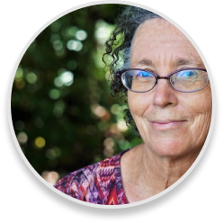
Meet Jeane Cooper
Diagnosis:
chronic kidney disease heart failure diabetes

Slide 6

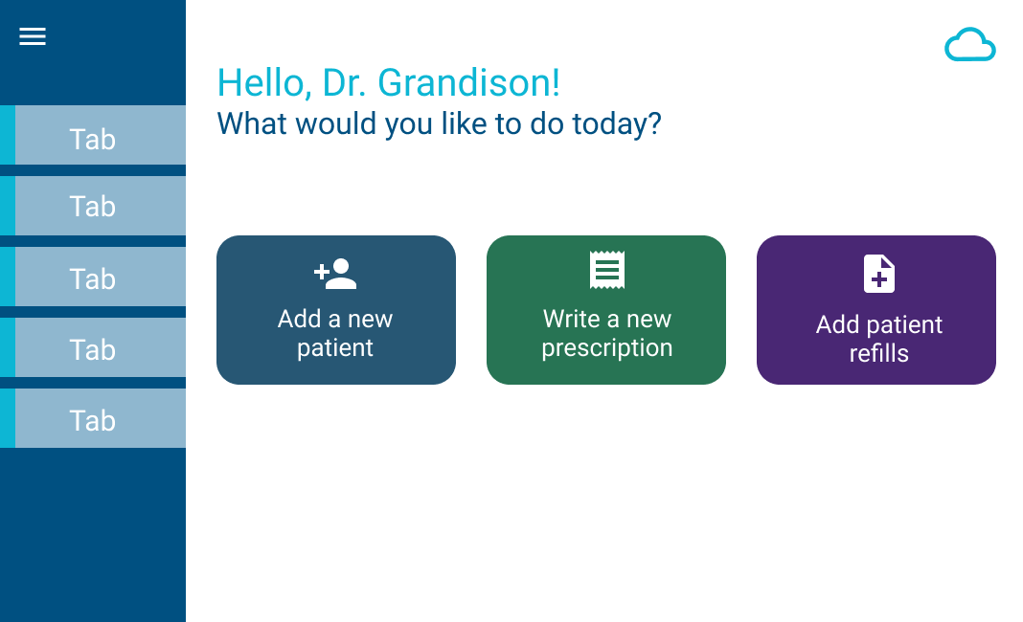
Our Solution
Improved patient outcomes
One-stop shop

